Slide 1

Major Project -2 Based Presentation MENTAL HEALTH PREDICTION IN STUDENTS Submitted to: Prof. V K Shrivastava School of Electronics Engineering Kalinga Institute of Industrial Technology (Deemed to be University).

Slide 2
ABSTRACT
Behavioral health treatment is grounded in the medical model with language of deficits and problems, rather than resources and strengths.
With developments in the field of positive psychology, re-focusing on well-being rather than illness is possible.
Studies have shown that mental health problems can negatively influence academic performance as well as personality disorders.
This paper makes use of Mental Health data-set available in the source repository.

Slide 3

Introduction
Mental health is a state of well-being in which an individual recognises his or her own potential, is able to cope with daily stressors, works successfully and productively, and contributes to his or her community.
Physical and mental health are the result of a complex interaction between a number of individual and environmental factors, including: Family history of illness and disease/genetics Lifestyle and health behaviour (e.g., smoking, exercise, substance use)
Levels of personal and workplace stress Exposure to toxins Exposure to trauma Personal life circumstances and history.
So here in these project we will be trying to predict three main outcomes of three mental health problems with the higest accuracy.

Slide 4

DATASET EXPLORATION
Dataset : Data was gathered from a group of domestic and international students at Ritsumeikan Asia Pacific University who completed the General Health Help-Seeking Questionnaire and Patient Health Questionnaire comprises of 286 rows and 50 columns
We obtained our data from a reliable source and then cleaned it by removing any unnecessary elements.
We employed feature selection techniques and then scaled it to fit our needs.

Slide 5
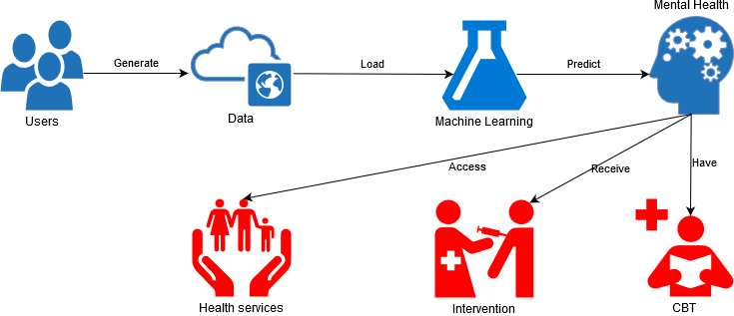
WORKING MODEL
Flow Chart is as follows :
Data Gets stored in our cloud web sever
Data gets uploaded in our model and starts pre-processing it
Our model predicts the disease and display the results to userend
Users Generate their data in the website

Slide 6
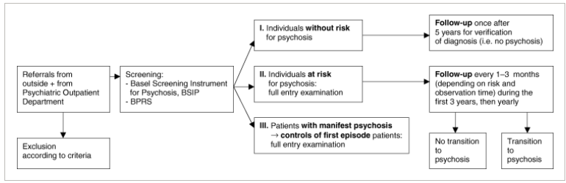
Usuage of Our Model
Used in Basel Psychosis Screening Instrument (BSIP). A technology that detects the most significant risk factors for mental illness or suicide ideation.
Our model can be used to inspire the architecture of this gadget, which will aid in the detection of mental illness in kids.
The BSIP is a checklist that includes guidelines for conducting a semi-structured clinical interview and covers seven criteria of importance for detecting psychosis early on

Slide 7

EDA
The data Preprocessing contains several checkpoints (steps) such as:
After importing our dataset, we remove duplicates,correct errors, deal with missing values, normalization, data type conversions.
We, too, use data visualization to aid in the detection of meaningful correlations between variables or class imbalances (bias alert! ), as well as perform additional exploratory analysis and divide data into training and evaluation sets.
We convert our categorical data into numerical representations

Slide 8

EDA
After conversion, we replaced the Nan values with ‘0’ or the average values of all the data in the column for analysis purposes.
To train our machine learning model, I utilized the capable machine learning library of python, scikit-learn or sklearn to partition this dataset into Test and Train datasets.
Done the parameter tunning, Model parameters that are fine-tuned boost performance.
Tested our model with the pre-processed data providing a better estimate of how the model will behave in the actual world.

Slide 9
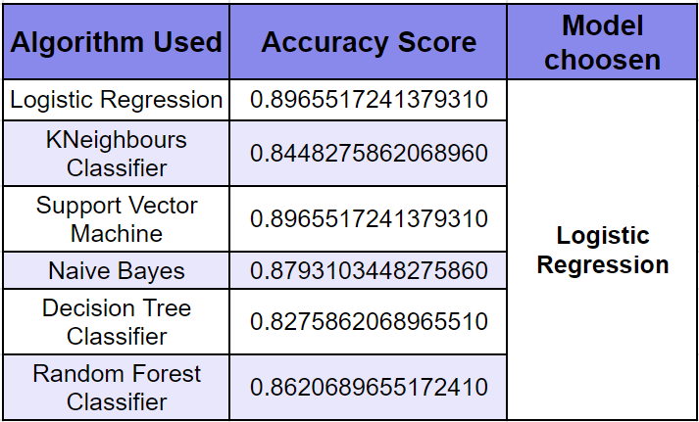
ALGORITHMS USED
Case A : Predicting whether the person given in the data is on the verge of attempting suicide or not - Logistic Regression
Notes:
nfyjgk

Slide 10
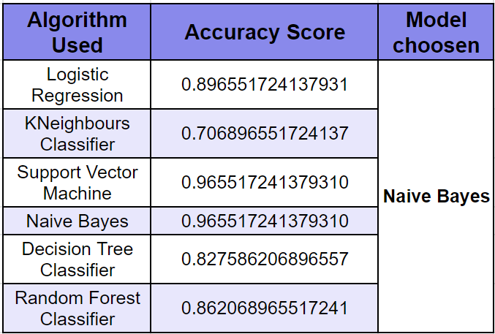
ALGORITHMS USED
Case B : Predicting whether a person is affected by depression or not - Naive Bayes
Notes:
nfyjgk

Slide 11
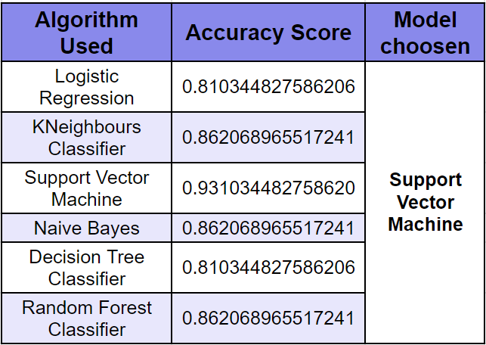
ALGORITHMS USED
Case C : Predicting whether a person is affected by Depression Severity - Support Vector Machine
Notes:
nfyjgk

Slide 12
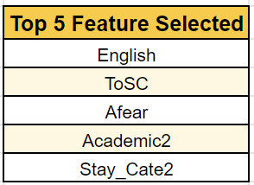
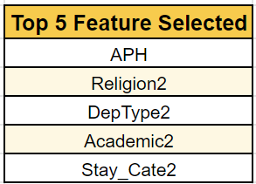
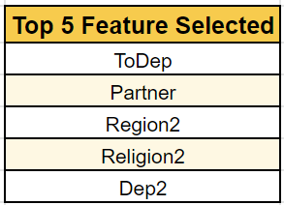
FEATURE SELECTION
USING EXTRA TREE CLASSIFIER :-
Case A : Predicting whether the person given in the data is on the verge of attempting suicide or not
Case B : Predicting whether a person is affected by depression or not
Case C : Predicting whether a person is affected by Depression Severity
Notes:
nfyjgk

Slide 13
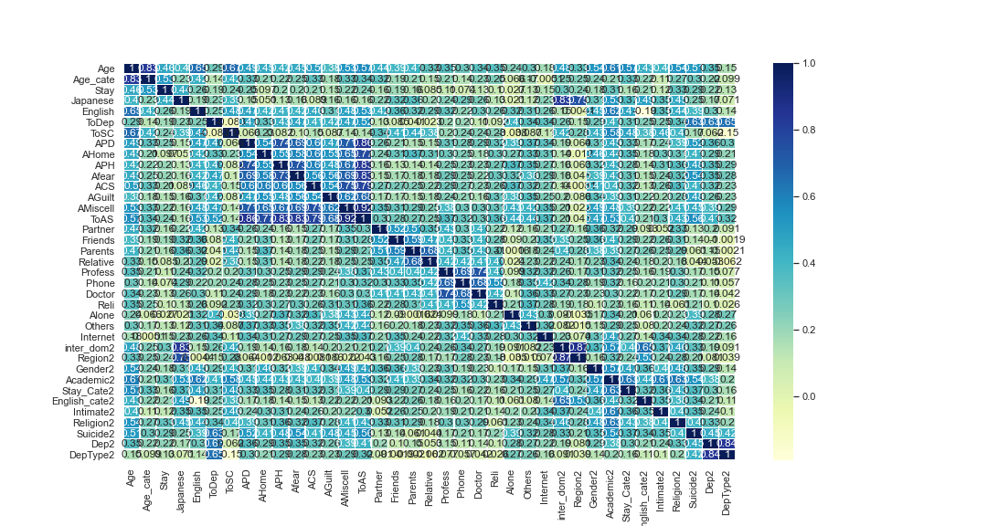
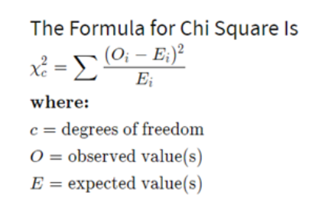
FEATURE SELECTION
HEAT MAP :-
CHI-SQUARE TEST:-
Notes:
nfyjgk

Slide 14
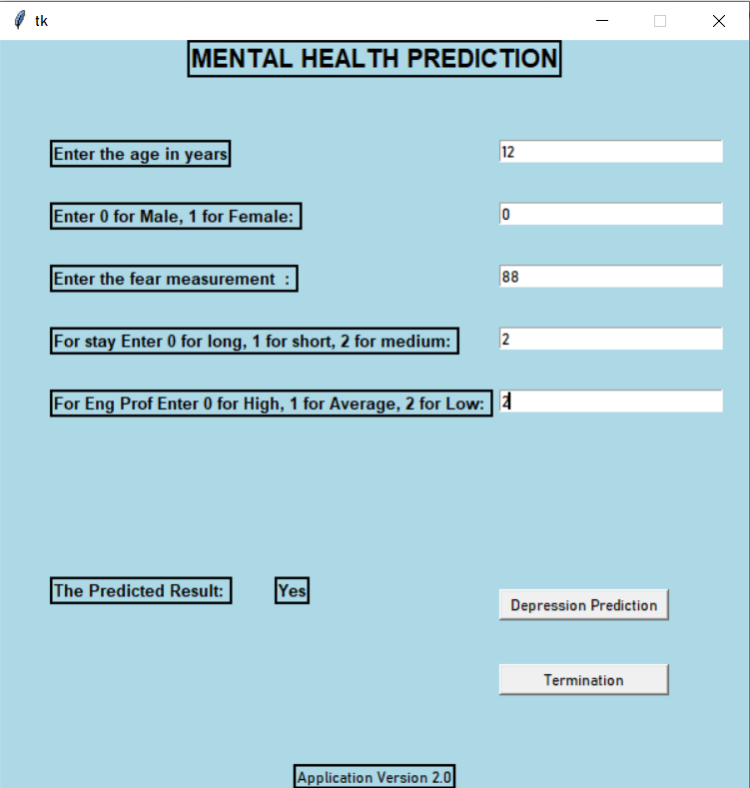
FUTURE PROSPECT
dsdsdsdAAAAA
In the next steps of its development it can be implemented to real life by using aweb framework or some GUI toolkit.
In our case we have used Tinkter, a GUI toolkit in order to implement with real human numbers.
A snapshot of that frame is attached for reference.

Slide 15
CONCLUSION
Many different techniques and algorithms had been introduced and proposed to test and solve the mental health problems. There are still many solutions that can be refined.
In addition, there are still many problems to be discovered and tested using a wide variety of settings in machine learning for the mental health domain.
As classifying the mental health data is generally a very challenging problem, the features used in the machine learning algorithms will significantly affect the performance of the classification.

Slide 16
Presented by
ANIS GHOSH (1804430) HARSH BANSAL (1804442) SIRAK GUHA NIYOGI (1804477) | SUMIT SAHA (1804485) TINA SASMAL (1804486) UTSAB GHOSH (1804488)

